Slide 1

UE18CS252
Database Management System
STOCK MARKET MANAGEMENT
Prof. Priya Badrinath
Section-F, B.Tech CSE
PES1201801127 G JAHNAVI REDDY

Slide 2
JAN-MAY 2020 STOCK MARKET MANAGEMENT
Table of contents
Introduction
Database Schema
ER Diagram
Functional Dependencies
Normalization
Testing lossless join property
Creating tables
Creating triggers
Writing Complex Queries

Slide 3
Introduction
Stocks deal with huge volumes of data which is accessed very often for the users to trade. This database management system is intended to provide users with easier access to the stock prices and other information required to trade.
Stockcomp table contains all the stock values of the companies
Top gainers and top losers displays the 52 week high and low prices for the users to make a decision to buy stocks
User_credentials has the information of all the users about their investment and networth
User_transaction has the information of individual stock transaction

Slide 4
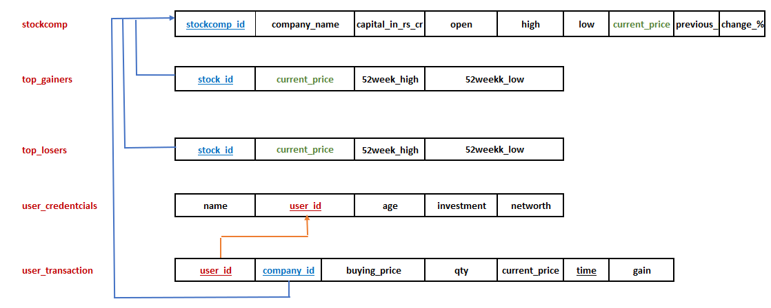
Stock Market Database Scheme

Slide 5
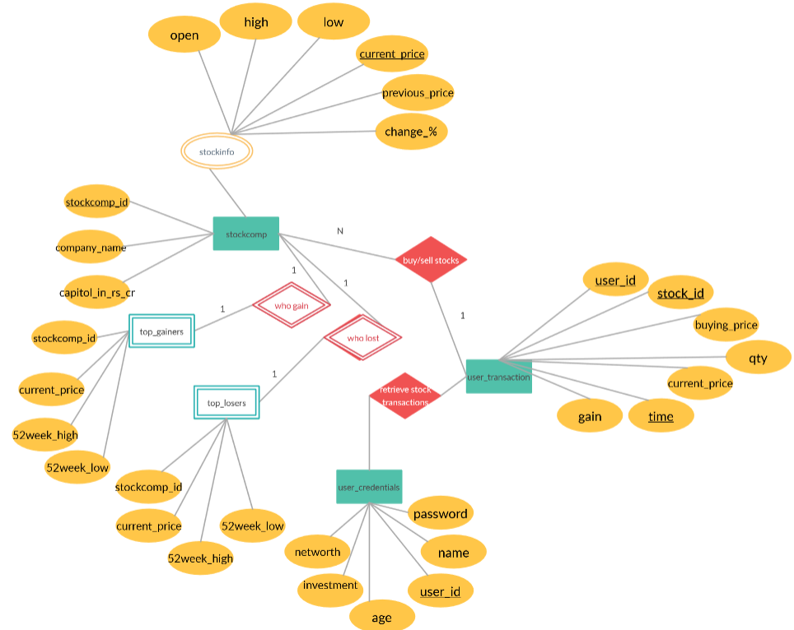
ER Diagram

Slide 6
Functional Dependencies
{stockcomp_id} →{ Company_name , capitol_in_rs_cr,open,high,low,current_price,previous_price,change_percentage}
{user_id}→{name,age,investment,networth,password}
{user_id,company_id,time)→{buying_price,qty,current_price,gain}

Slide 7
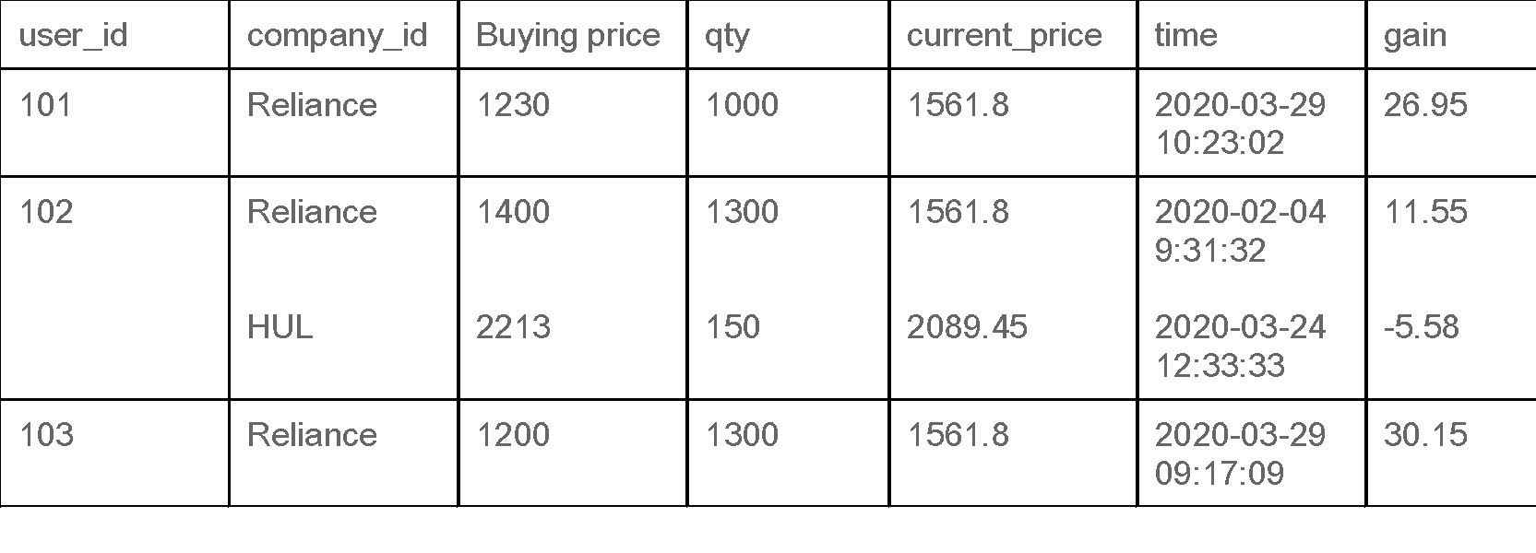
Normalization - First normal form (1NF)
Use_id 102 has bought stocks in more than one company.
This table is not in 1NF as the rule says “each attribute of a table must have atomic (single) values”.

Slide 8
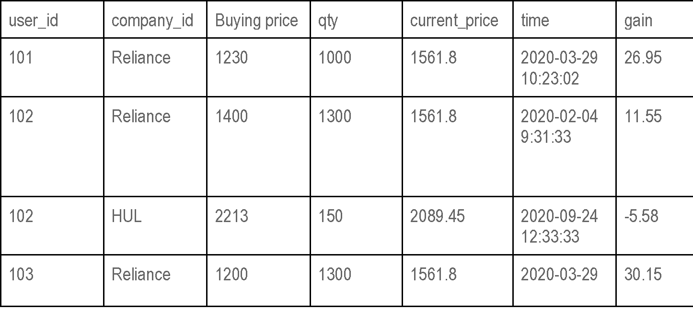
Normalization - First normal form (1NF) cont…
To make the table complies with 1NF we should have the data like this:

Slide 9
Normalization -
A table is said to be in 2NF if both the following conditions hold:
Table is in 1NF (First normal form)
No non-prime attribute is dependent on the proper subset of any candidate key of table.
A table design is said to be in 3NF if both the following conditions hold:
Table must be in 2NF
Transitive functional dependency of non-prime attribute on any super key should be removed.
Boyce Codd normal form (BCNF)
It is an advanced version of 3NF that’s why it is also referred as 3.5NF. BCNF is stricter than 3NF. A table complies with BCNF if it is in 3NF and for every functional dependency X->Y, X should be the super key of the table.

Slide 10
TESTING LOSSLESS JOIN PROPERTY
Decomposition of a relation is done when a relation in relational model is not in appropriate normal form. Relation R is decomposed into two or more relations if decomposition is lossless join as well as dependency preserving.
Lossless Join Decomposition
If we decompose a relation R into relations R1 and R2,
Decomposition is lossy if R1 ⋈ R2 ⊃ R
Decomposition is lossless if R1 ⋈ R2 = R
To check for lossless join decomposition using FD set, following conditions must hold:
Union of Attributes of R1 and R2 must be equal to attribute of R. Each attribute of R must be either in R1 or in R2. Att(R1) U Att(R2) = Att(R)
Intersection of Attributes of R1 and R2 must not be NULL. Att(R1) ∩ Att(R2) ≠ Φ
Common attribute must be a key for at least one relation (R1 or R2) Att(R1) ∩ Att(R2) -> Att(R1) or Att(R1) ∩ Att(R2) -> Att(R2)
Checking lossless join property on stock market database system, we can conclude that relation has lossy decomposition

Slide 11
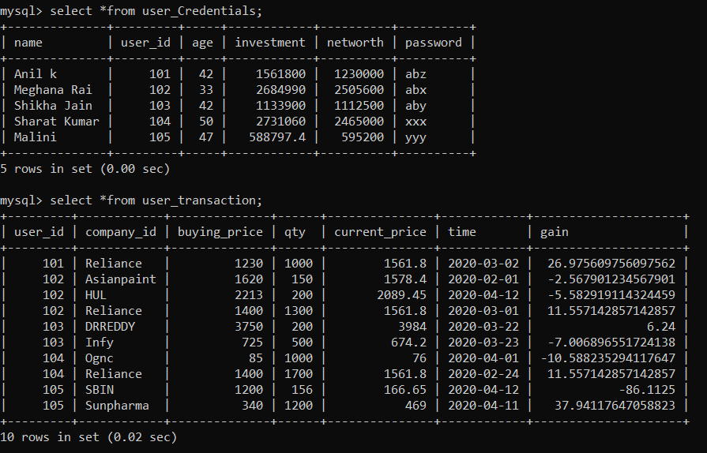
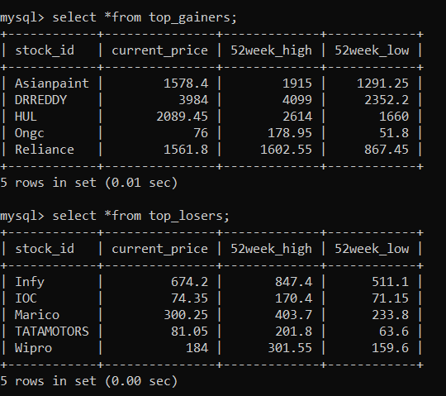
Screenshots of tables

Slide 12
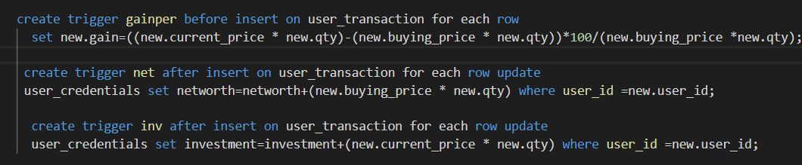
Creating Triggers
There are three triggers in the database.
Trigger gainper - Calculates the percentage gain of individual stock bought by an individual user. This percentage gain statistic can help users to decide to buy or sell stocks for their own profits
Trigger inv -Calculates the total investment made by the user buying all the stocks and updates whenever the user buys new stocks
Trigger net- Calculates the total net worth of the users based on the current price of all the stocks bought by him/her.

Slide 13
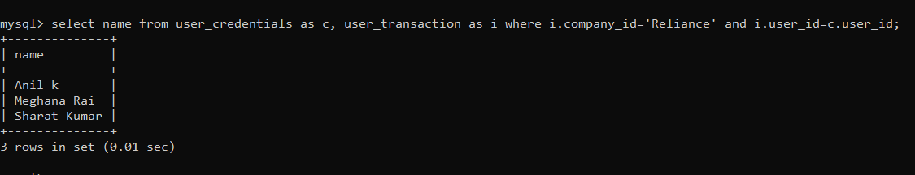
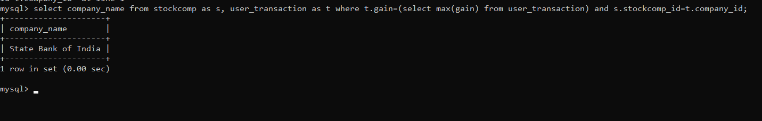
Complex SQL queries
Display the name of the users who have invested in ‘Reliance Industries Ltd.
Display the company name which has brought maximum profit to users who bought the stock individually.

Slide 14
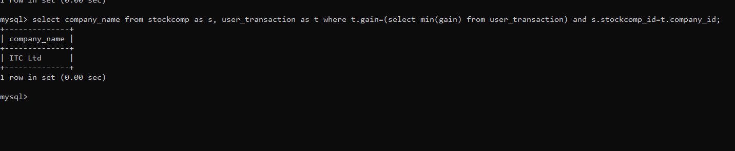
Complex SQL queries cont…..
Display the company name which has brought minimum profit to users who bought the stock individually.

